Slide 1
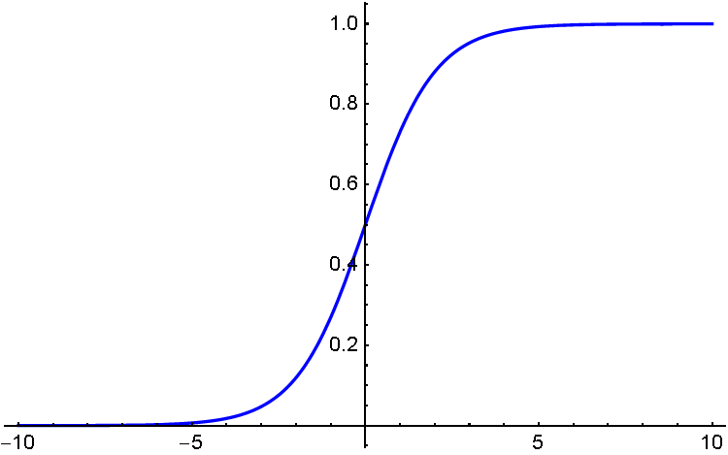
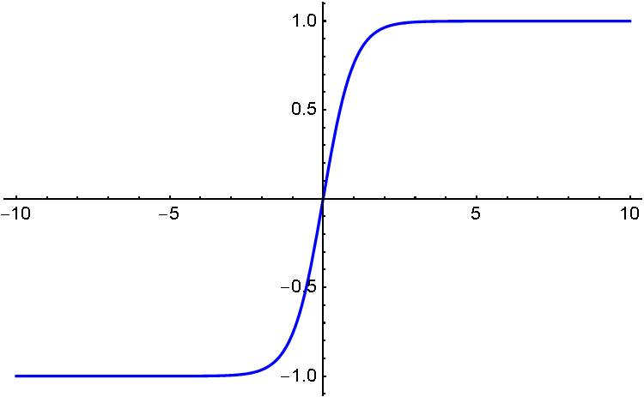
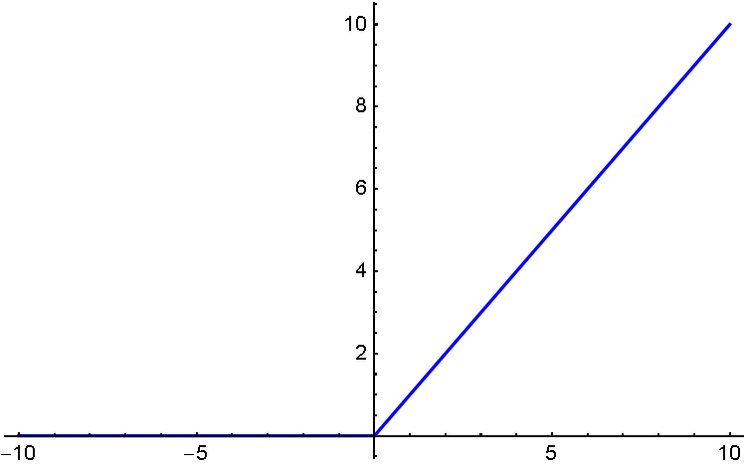

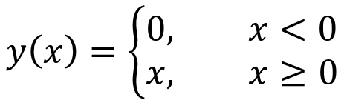




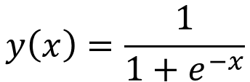

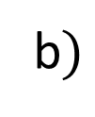



$$y$$
$$y$$
$$y$$
$$y\left(x\right)=\tanh{x}$$
$$y\left(x\right)=\frac{1}{1+e^{−x}}$$
$$x$$
$$y\left(x\right)=\left\{\begin{aligned}0, x<0 \\ &x, x≥0\end{aligned}\right.$$
$$x$$
$$x$$
$$a)$$
b$)$
c$)$

Slide 2
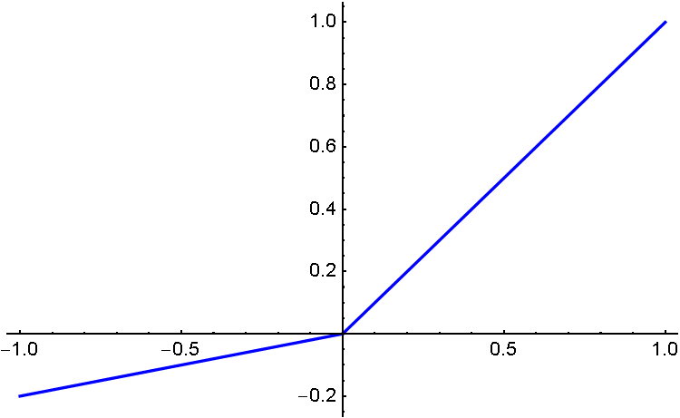
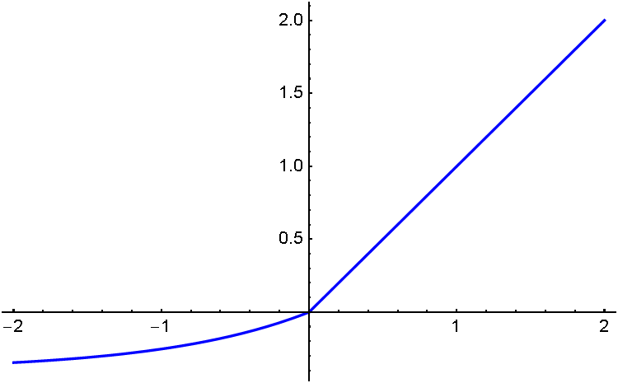

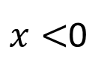


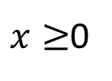
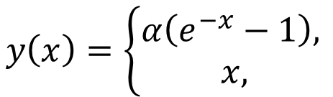

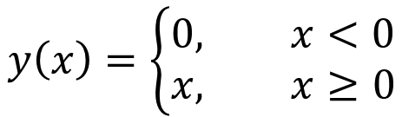
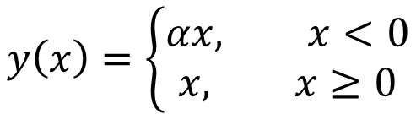


$$y$$
$$y$$
$$y$$
$$y\left(x\right)=\left\{\begin{aligned}αx, x<0 \\ &x, x≥0\end{aligned}\right.$$
$$y\left(x\right)=\left\{\begin{aligned}α\left(e^{−x}−1\right), \\ &x, \end{aligned}\right.$$
$x≥$0
$x<$0
$$y\left(x\right)=\left\{\begin{aligned}0, x<0 \\ &x, x≥0\end{aligned}\right.$$
$$x$$
$$x$$
$$x$$
$$a)$$
b$)$
c$)$

